Slide 1
Celonis Exercises
Exercise Sheet 1: Process Explorer

Slide 2
Exercise 1 Overview
In this task, we want to get familiar with the Process Explorer.
Firstly, follow the instructions from the Introduction to Celonis presentation to upload the given (reduced) financial event log of a real-world loan application process¹ in Celonis and get familiar with the tools provided by Celonis Studio.
Next, use the Process Explorer component to investigate the process as instructed in the assignment.
¹Adapted dataset (with the 612 most frequent variants) from: van Dongen, Boudewijn (2012): BPI Challenge 2012. Version 1. 4TU.ResearchData. dataset.
https://doi.org/10.4121/uuid:3926db30-f712-4394-aebc-75976070e91f

Slide 3
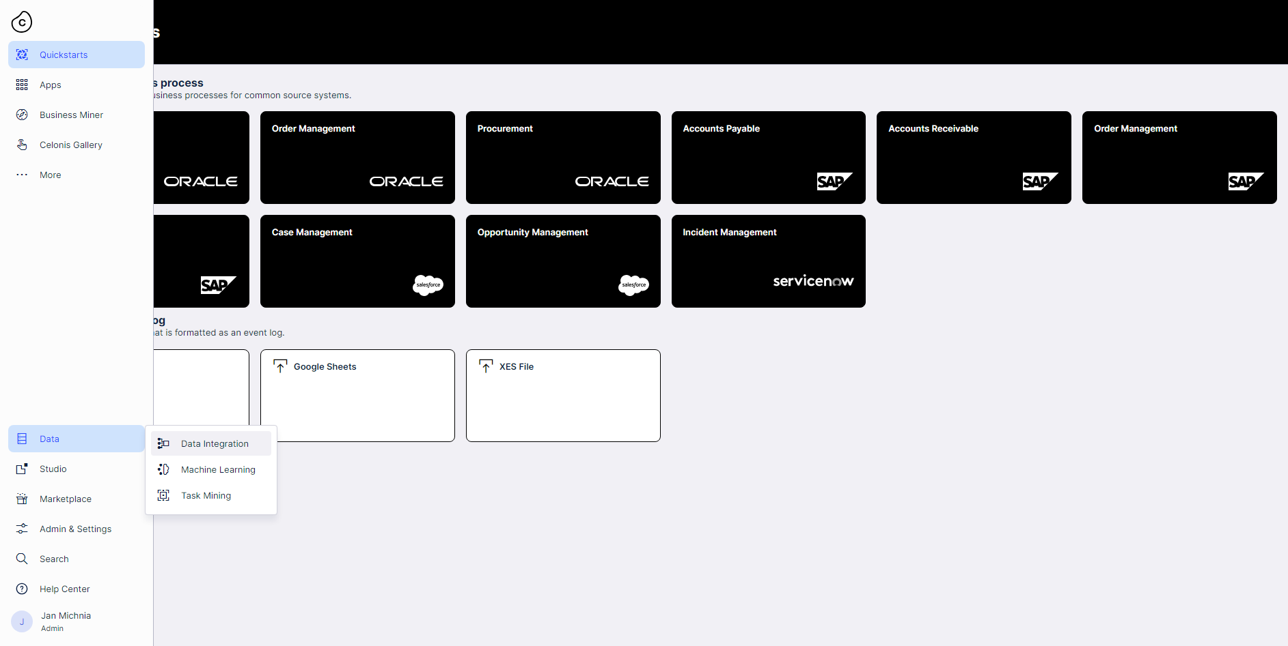

Exercise 1
Upload the event log
Firstly, we briefly repeat how to upload the event log to Celonis. We skip some steps inbetween. For a proper rundown of how to upload your event log, take a look at the Introduction to Celonis slides.

Slide 4
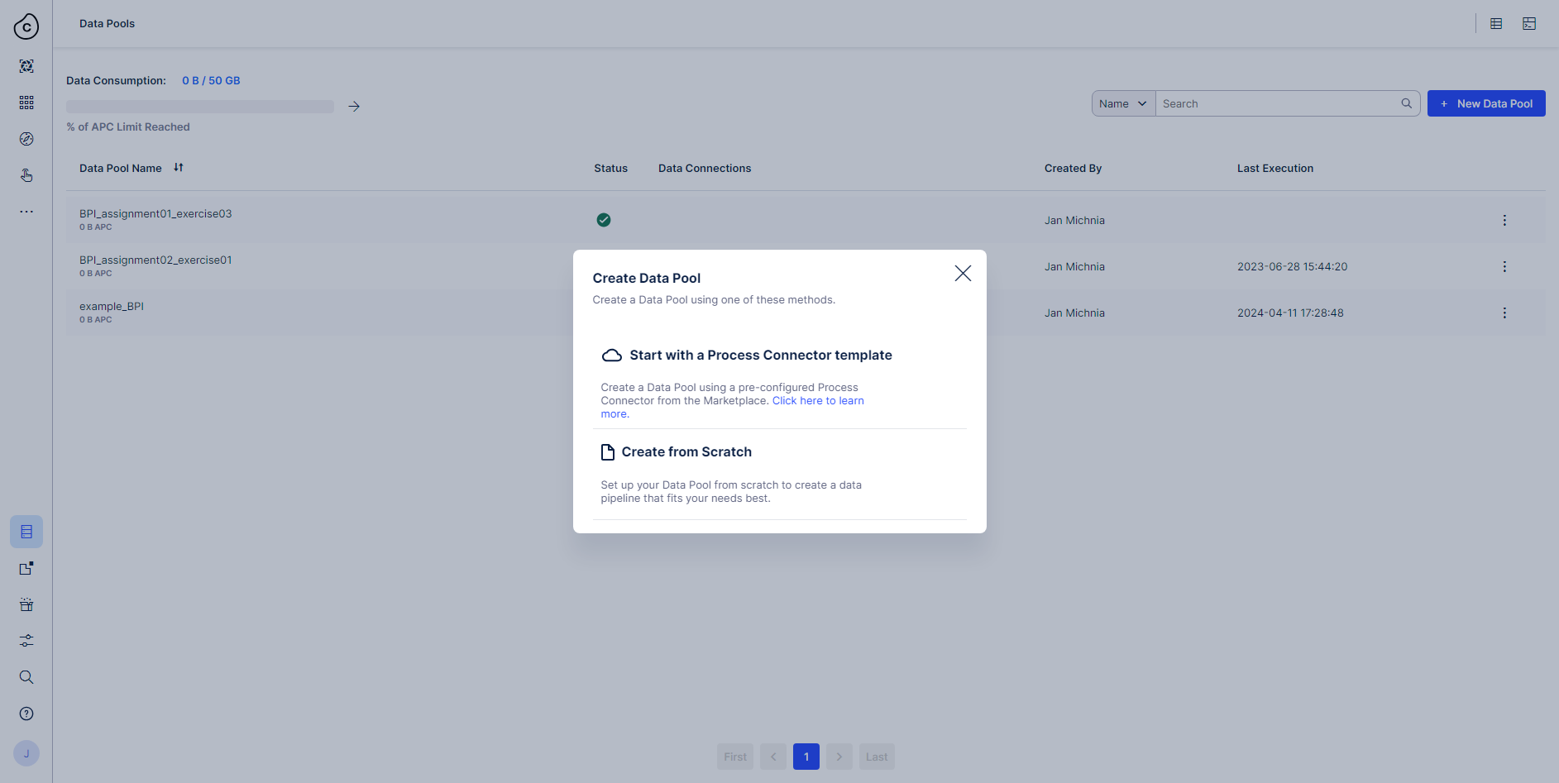
Exercise 1
Upload the event log

Slide 5
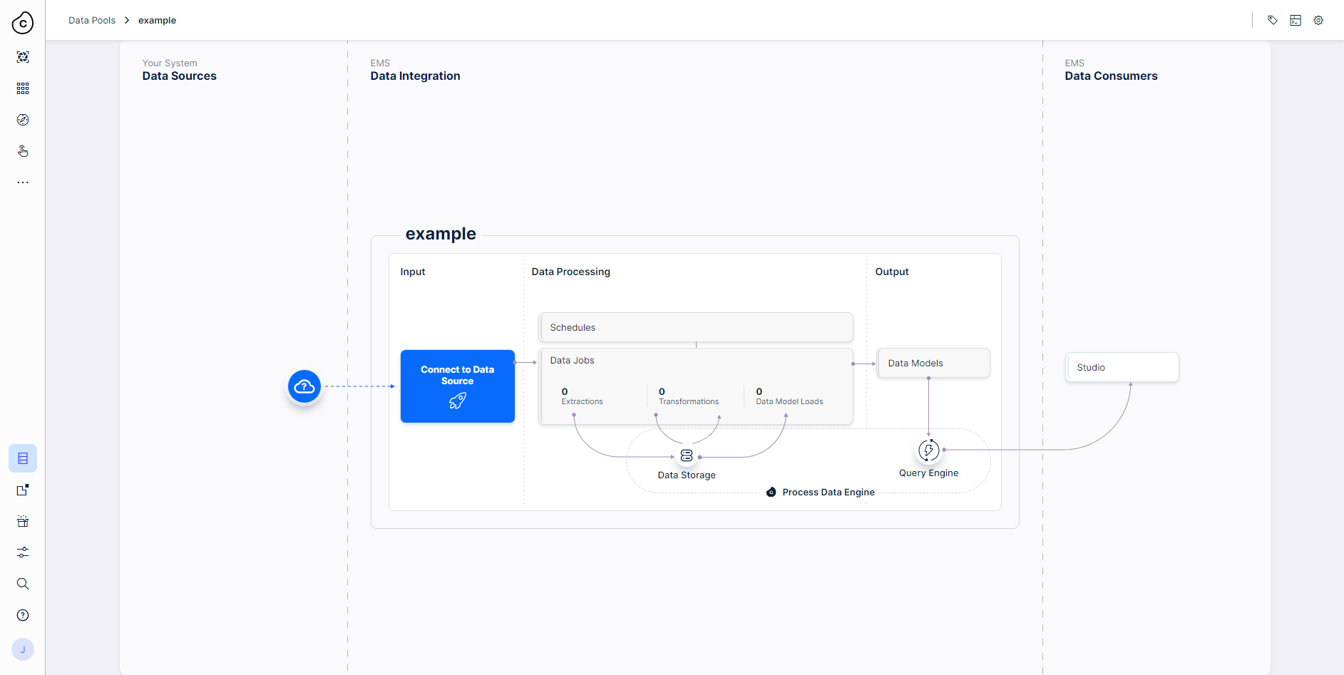
Exercise 1
Upload the event log

Slide 6
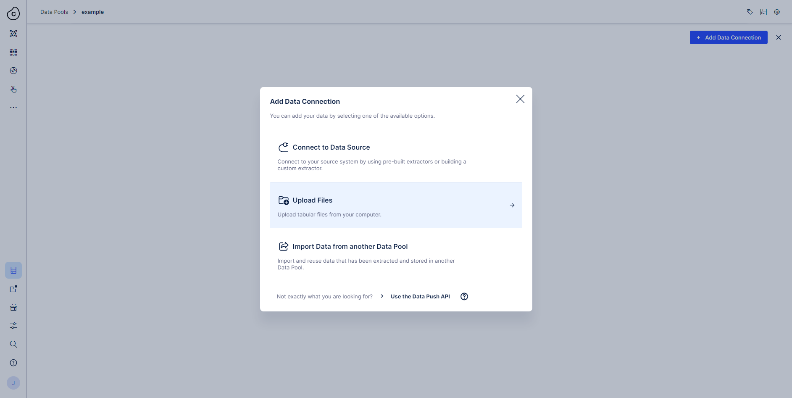
Exercise 1
Upload the event log

Slide 7
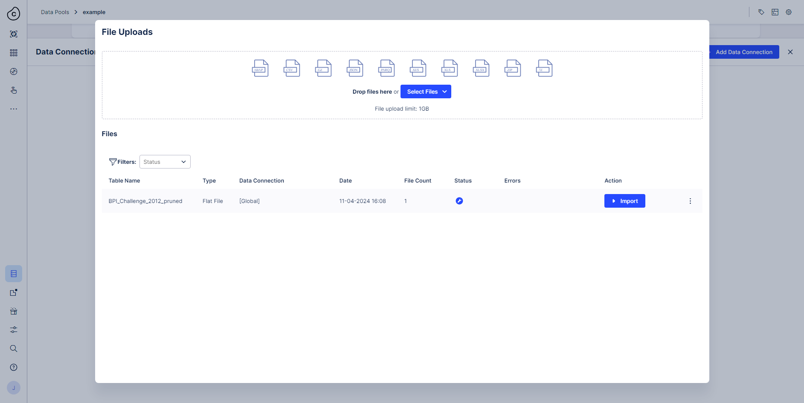
Exercise 1
Upload the event log
Select our provided example log ‘BPI_Challenge_2012_pruned.xes.gz’.
Adapted dataset (with the 612 most frequent variants) from: van Dongen, Boudewijn (2012): BPI Challenge 2012. Version 1. 4TU.ResearchData. dataset.
https://doi.org/10.4121/uuid:3926db30-f712-4394-aebc-75976070e91f

Slide 8

Exercise 1
Upload the event log

Slide 9
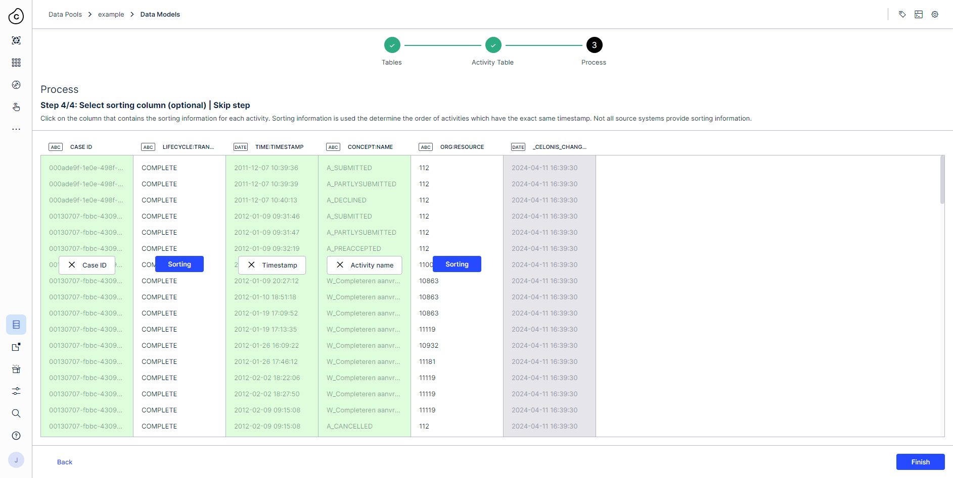
Exercise 1
Upload the event log

Slide 10
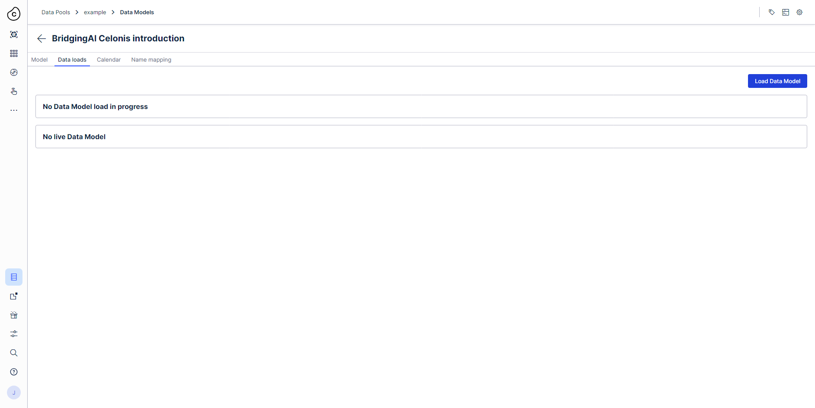
Exercise 1
Upload the event log

Slide 11
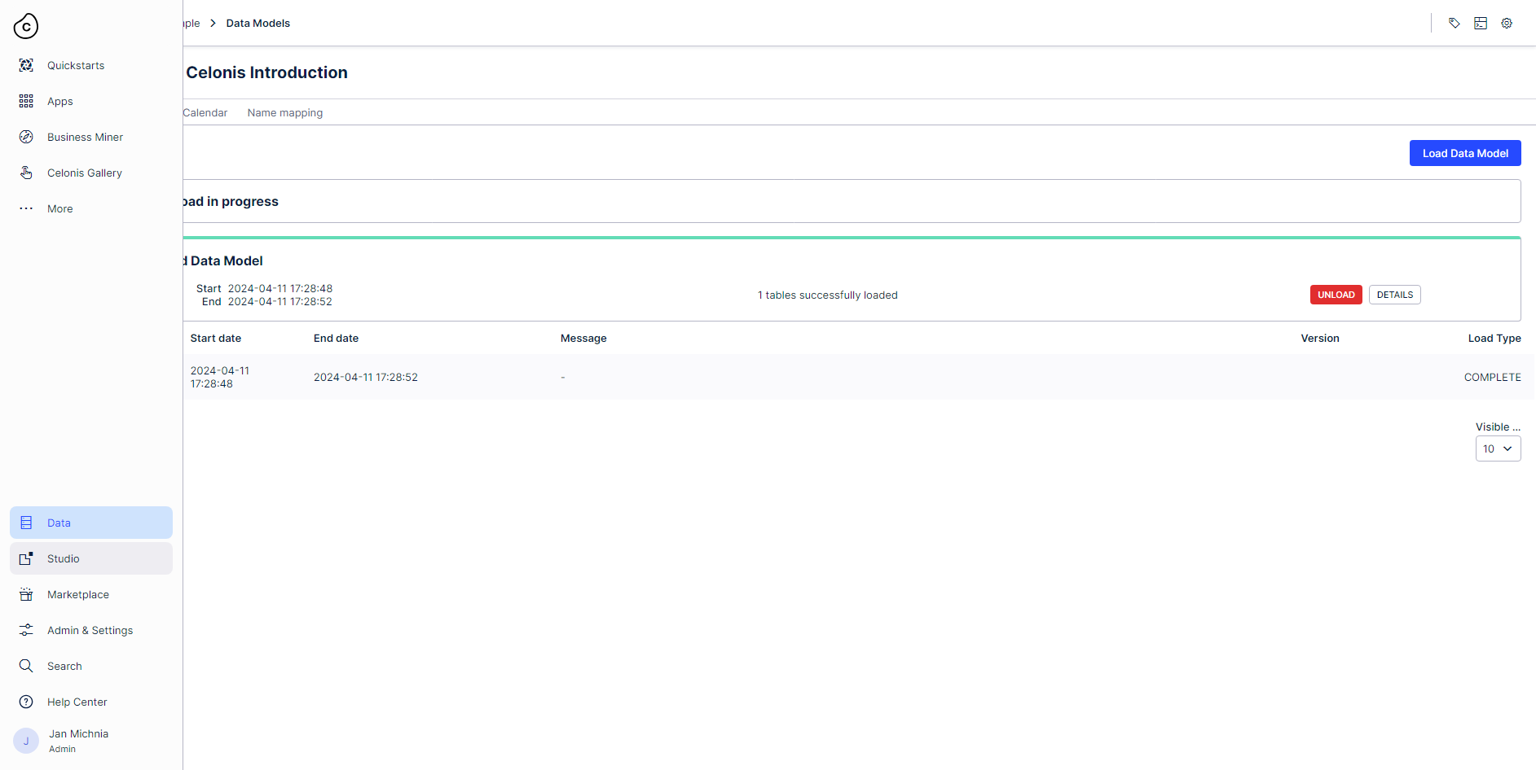
Exercise 1
Switch to Celonis Studio and create a new Process Explorer component in your BridgingAI Analysis (create it as described in the Introduction to Celonis slides).
In the following, we present the assignments.

Slide 12
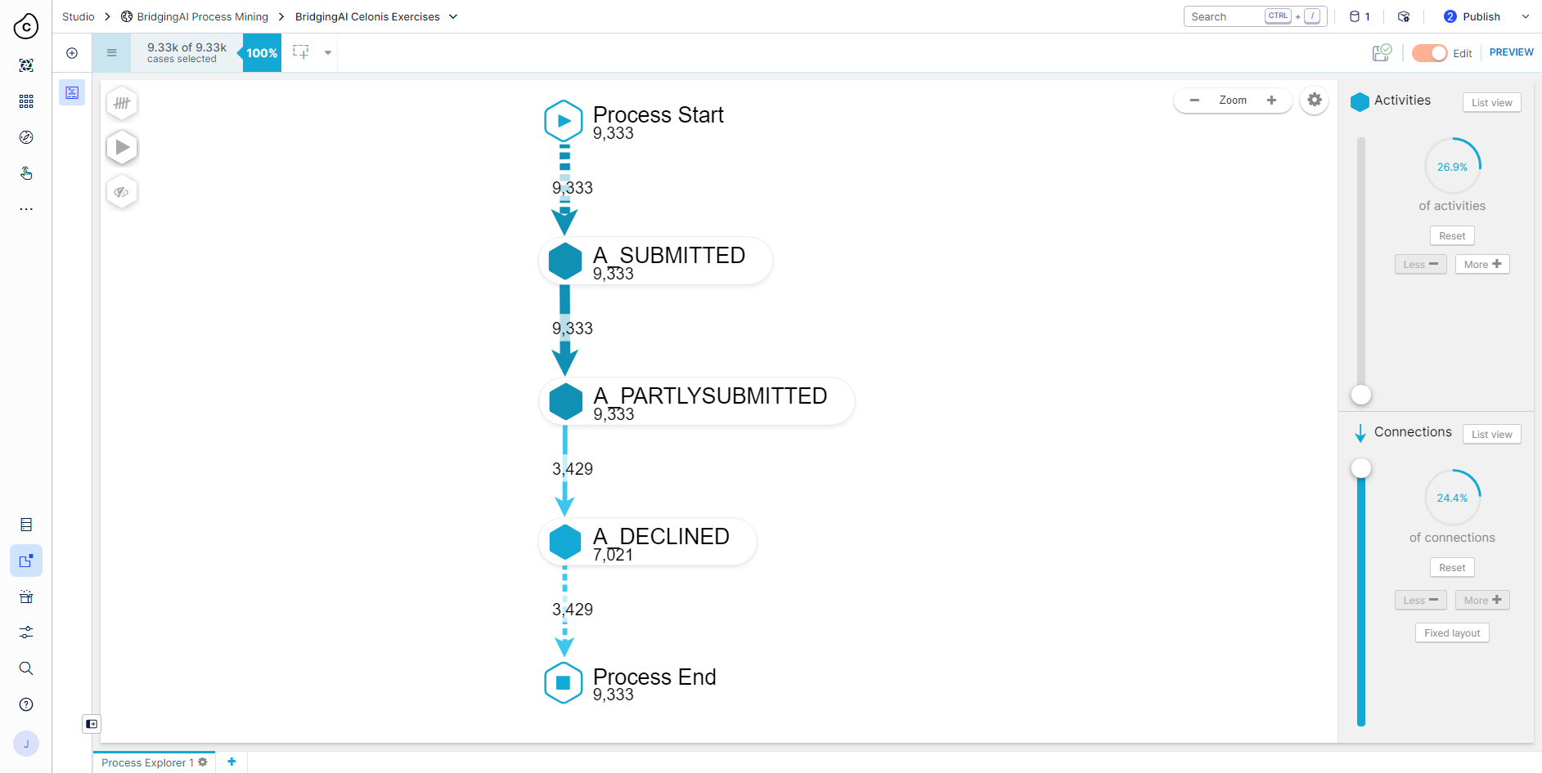
Exercise 1
This should be your initial view of the Process model.
Exercise 1.a) Create a DFG for the 75,3% most common activities that includes the 70,6% most common connections.

Slide 13
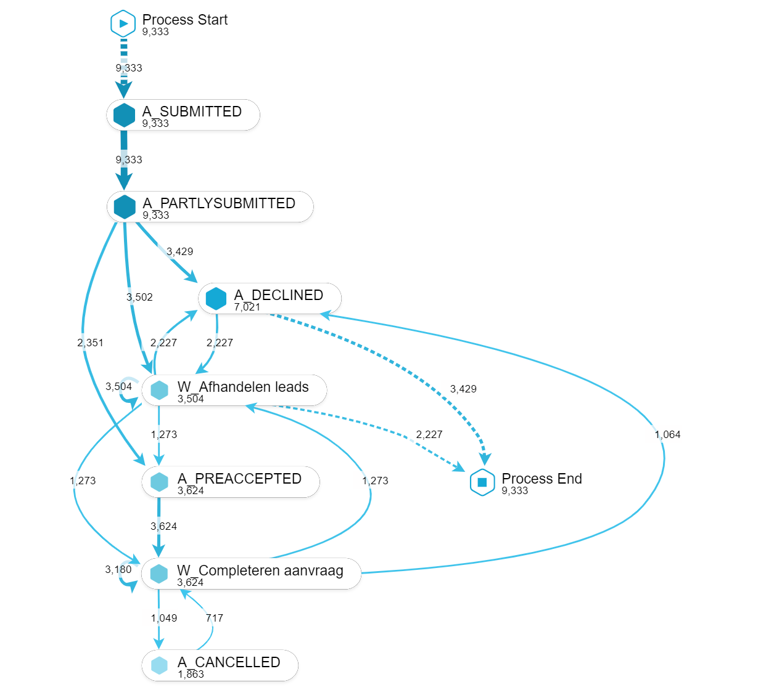
Exercise 1
The resulting DFG should look like this. Answer the following questions.
Exercise 1.b) What do the numbers on the arcs and nodes of the DFG represent?
Exercise 1.c) What should be the relation between the sum of the numbers for the ingoing arcs of the node “Process End” and the number on the node “Process End” in the full DFG? Why does the relation not hold in the created DFG?
Exercise 1.d) What is the minimal percentage of activities considered for the DFG to make the relation from the previous question hold? Experiment with the activity and connection sliders. You can also click nodes to get further information on their connections wrt. the whole log.

Slide 14
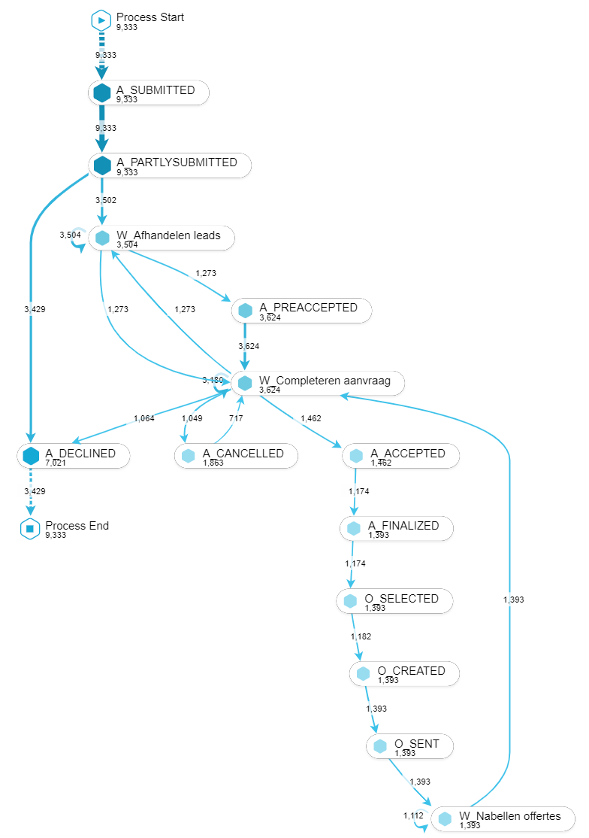
Exercise 1
Exercise 1.e) Create the DFG for the 94,6% most common activities and 77,7% most common connections.
The corresponding output DFG is shown on the left. Instead of case frequency, display the average throughput time in hours to answer the last assignment.
Exercise 1.f) What is the longest average throughput time and between which activities does it happen? What about the median throughput time? Explain why they might deviate.
Good Luck with the Exercise and have fun discovering Celonis! 🎉

